Slide 1

Machine Learning for Predicting GDP Growth
Enrico Fiori ferraz

Slide 2
IMPORTANCE OF predicting gdp growth
In economic planning and policy-making, GDP growth is one of the most important aspects for a country development;
Predicting GDP growth is challenging, considering its dependence on a lot of factors, which can be difficult to accurately define;
The scope of this project is to investigate how government debt and others factors can be used to predict GDP growth.

Slide 3
About the dataset
Problems in Dataset:
Main Source: World Bank
Time Frame: From 1980 to 2020
Number of countries: 196
Features: 17 (all numerical)
GDP Growth is the target!
Almost half of the columns have more than 20% null or NaN values

Slide 4
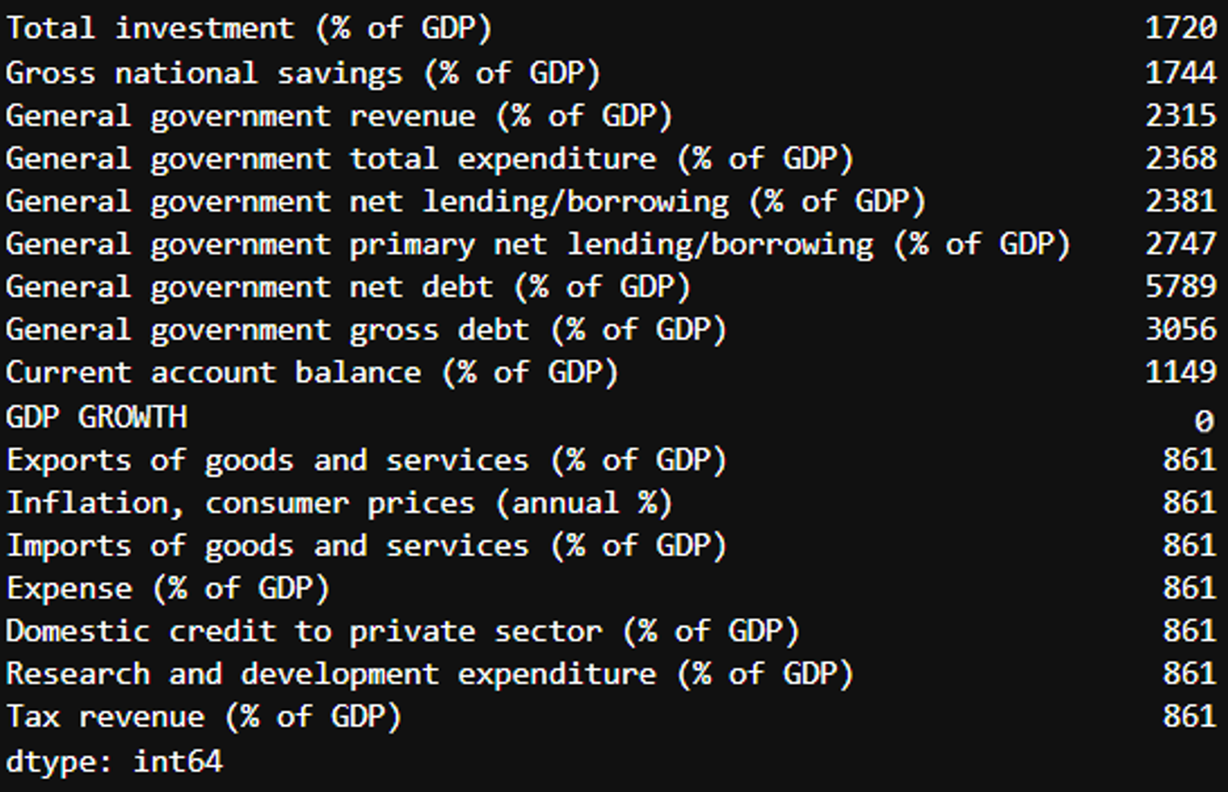
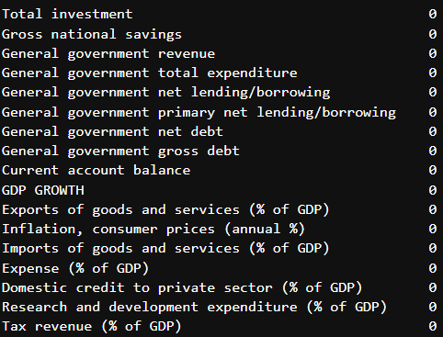
Preprocessing and Data Cleaning
Raw data
Processed data
Simple
Imputer
mean()

Slide 5
Models trained
Extra Trees Regressor
Random Forest Regressor
K Neighbors Regressor
Good for GDP growth forecasts as it balances between randomness and precision in economic predictions
Suitable for GDP growth prediction as it handles complex relationships and interactions among the data.
Effective for GDP growth prediction due to its reliance on nearby observations for forecasting.

Slide 6
Performance metrics
MODEL | MAE | MSE | R-SQUARED | N. ESTIMATORS | N. NEIGHBORS
Extra Trees | 2.5060 | 19.1982 | 0.1983 | 300 | -
Random Forest | 2.5740 | 20.4767 | 0.1449 | 300 | -
K-Neighbors | 2.7167 | 218187 | 0.0888 | - | 7
MAE is the best metric for this problem because the idea is to know how much the predictions on average deviate from real values of GDP Growth

Slide 7
Conclusion and next steps
Find more data to accurately fulfill the gaps in the original dataset;
Even the best model (Extra Trees) trained could not properly predict the GDP growth with the features provided;
For the problem the model is tackling, ~2.5% of error is a lot;
Get more data of different indicators, not only government and trade data.

